Slide 1
Routing in Satellite Networks: Use Cases, Challenges & Consideration
Peng Liu, Tianji Jiang
China Mobile
Sidemeeting @IETF 122 (March 19, 2025)
(Bangkok, Thailand)
Notes:
Actually, this draft was discussed about twice or three times in the past. But with the development of 5G and the related mobility function extensions, we think it can be a part of the 5G mobility management information.

Slide 2
Satellite Network for 3GPP Wireless Access
3GPP Rel-18: Satellite as ‘Transparent’ Relay (~June 2023)
Satellite constellation network being the infrastructure for wireless access and backhaul, it provides the gNB, front haul and back haul transport functionalities.
Satellite Network for 3GPP Wireless Backhaul
+--------------+ +---------+ +-------------+ +--------+
| T or | |Satellite| |Mobile Access| | WCN/ |
| Local network+---+ Network +---+ Network +---+ DNN |
+--------------+ +---------+ +-------------+ +--------+
End user terminal or local network accesses DNN
through Satellite Network and Mobile Access Network
+--------------+ +-------------+ +---------+ +--------+
| T or | |Mobile Access| |Satellite| | WCN/ |
| Local network+----+ Network +----+ Network +----+ DNN |
+--------------+ +-------------+ +---------+ +--------+
End user terminal or local network accesses DNN
through Mobile Access Network and then Satellite Network
Satellite as a transparent relay
No Inter-Satellite-Link (ISL), i.e., so-called ‘bent-pipe’
No layer-2/layer-3 packet processing, but only layer-1 functionalities like RF filtering, frequency conversion, etc.
Notes:
We simply list some principles for the protocol selection, for example, in order to improve the efficiency and reduce the load on the terminal, the network based protocol should have higher priority. And besides, a scheme is needed in order to negotiate the capability and preference between terminal and network.

Slide 3
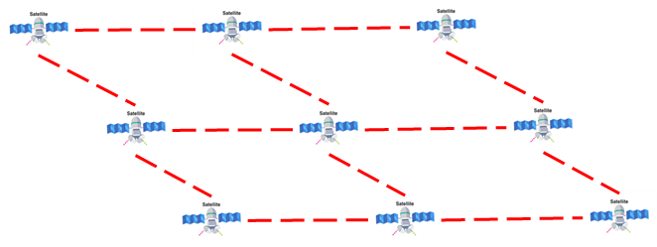


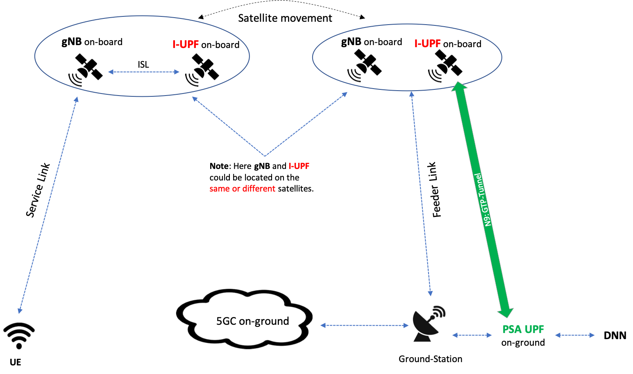
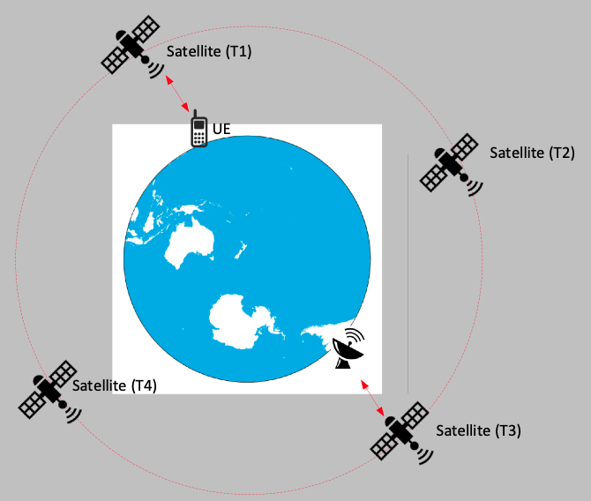
3GPP Rel-19 Satellite w/ Regenerative Forwarding (~March 2025)
Satellite w/ regenerative payload (gNB on-board)
Multi-satellites with Inter-Satellite-Links (ISLs)
High-layer functionalities:
Packet processing, L2 or L3 networking, Large scale networking
Criticalness of ISLs & SAT-Network:
Note: ISLs out of 3GPP scope, but matter to IETF.
Use ISL,
satellites form network
Internet
* These two scenarios selected from the 3GPP SA2: TR 23.700-29
Notes:
We simply list some principles for the protocol selection, for example, in order to improve the efficiency and reduce the load on the terminal, the network based protocol should have higher priority. And besides, a scheme is needed in order to negotiate the capability and preference between terminal and network.

Slide 4
Geolocation Shifting of Satellite after One-round
Earth self-rotating at approximately 460 meters/sec at the equator
Assuming a LEO satellite could rotate the Earth one-round in 95 mins (may depend on the satellite's rotation track):
Shift-distance on Earth = Earth-self-rotation-speed * Self-rotation-period
Then, we have, 460 m/s * (95 mins * 60 sec/min) ~ 2600 KM.
Indicating the geolocation-shifting at the equator (relative to Earth) after one round could be more than 2000 Km.
This significant shifting is way beyond the coverage of a RAN on-board (i.e., regenerative) a LEO satellite.
Conclusion:
A Satellite constellation network w/ inter-satellite links (or ISLs) is the necessary solution
* Routing in Satellite Networks: Challenges & Considerations, draft-lj-rtgwg-sat-routing-consideration.
Notes:
We simply list some principles for the protocol selection, for example, in order to improve the efficiency and reduce the load on the terminal, the network based protocol should have higher priority. And besides, a scheme is needed in order to negotiate the capability and preference between terminal and network.

Slide 5
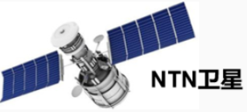

3GPP Rel-20: Multi-orbit satellite access for service continuity (On-going)
GEO
GEO-1
GEO-2
3
Considerations:
End-to-end latency: LEO/MEO/GEO: 35ms ~ 285ms
Power consumption
Service continuity
MEO-B
MEO
MEO-A
MEO-c
2
ISL_1
LEO-d
ISL_2
LEO-b
LEO-e
LEO
LEO-f
ISL
LEO-a
LEO-c
Ground
(GS/TN)
UE/CN
UE/CN
UE/CN
Scenario#1: UE – UE/CN covered by a single LEO and also by a single MEO
Scenario#2: UE – UE/CN Not-covered by a single LEO, but covered by a single MEO
Scenario#3: UE – UE/CN Not-covered by a single LEO, nor covered by a single MEO, but covered by a GEO.

Slide 6
Multi-orbit SAT-Networks: Problems & Challenges
Challenge #1: The very dynamics of routing topology
Dynamics between (on-ground) routing nodes and satellites: changing neighborship and varied distance (impacting ‘link cost’ associated with a routing protocol)
Dynamics among satellite nodes: Fast-moving satellites, on the same/opposite/angled directions, trigger the intermittent peering relationship.
Challenge #2: The limited bandwidth of peering links
links between peering satellites and between satellites and ground-stations or (on-ground) MEs renders fairly limited link bandwidth (BW)
Data from field case-1: measured UL/DL rate via a GEO satellite only @ 10 Kbps
Data from field case-2: LEO at the orbit height 550 Km - measured rate UL @ 5 Mbps, DL @ 1 Mbps and ISLs @ 230 Mbps.
Challenge #3: The HW limitation & reduced capabilities
Harsh & challenging environment: temperature, near-vacuum, radiation, etc.
Expensive to carry load upon rocket launch
RedCap HW to fulfill intra- and inter- satellite routing
Challenges:
link-quality/cost, routing convergence, LSP exchange, LSDB sync-up, computational load, IGP/BGP advertise/withdraw, etc.
Notes:
We simply list some principles for the protocol selection, for example, in order to improve the efficiency and reduce the load on the terminal, the network based protocol should have higher priority. And besides, a scheme is needed in order to negotiate the capability and preference between terminal and network.

Slide 7
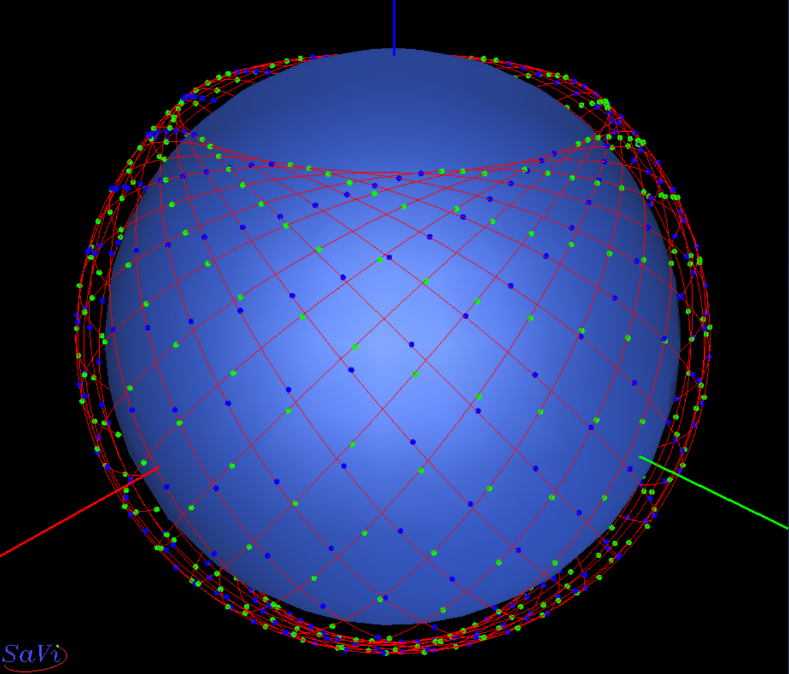
Satellite-Routing: Uniqueness, Considerations
Uniqueness
Predictable & pre-determined satellite ‘footprint’ (i.e., trajectory, velocity, etc.)
Ephemeris: height, inclination, azimuth, time-changed track, etc.
Use case: (5G) ‘Predictable’ SAT-based QoS probing optimization for dynamic backhaul service
Routing Considerations for Multi-orbit SAT Network:
No full-set routing intelligence on-board satellites
Adoption of layered routing structure: TN vs. NTN
A traditional routing scheme running for the 'overlay’ Terrestrial Network or TN, and
A novel switching scheme operating exclusively for the 'underlay’ Non-Terrestrial Network or NTN
Impact of the ‘multi-orbit’ objective:
Different roles of LEO/MEO/GEO may impact the topology design and routing-logic selection.
Simplified traffic forwarding logics on-board satellites via ‘predictable’ info.
Incorporate more intelligence into the routing scheme & path selection, e.g., CATS-like variations.
Han, L. and et al., "Evolution to 6G for Satellite NTN Integration: From Networking
Perspective", https://qualitativesemantic.wordpress.com/, October 2023.
Notes:
We simply list some principles for the protocol selection, for example, in order to improve the efficiency and reduce the load on the terminal, the network based protocol should have higher priority. And besides, a scheme is needed in order to negotiate the capability and preference between terminal and network.

Slide 8
Summary
Use cases & evolutions from 3GPP:
3GPP Rel-18: Satellite as transparent relay
3GPP Rel-19: Satellite with regenerative forwarding
3GPP Rel-20: Multi-orbit satellite access for service continuity
Criticalness of SAT-network & ISL:
E.g., Geolocation Shifting of Satellite after One-round
SAT-Routing: Problems, Challenges, Uniqueness, and Considerations
Problems & challenges
Uniqueness – predictable & pre-determined (e.g., Ephemeris)
Multi-orbit routing Considerations
Notes:
So, that’s all and thank you very much. And we also want to know is it possible for a WG adoption of this draft?

Slide 9
Thank you!
Notes:
So, that’s all and thank you very much. And we also want to know is it possible for a WG adoption of this draft?

